Slide 1
Principal Component Analysis
By Amrita Panjwani

Slide 2
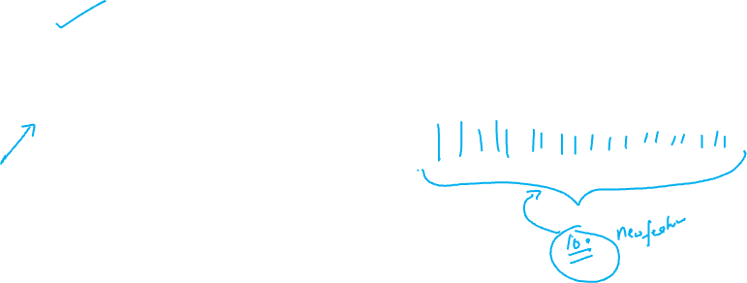
Principal Component Analysis
It is a unsupervised machine learning algorithm that is used to reduce the dimensionality of the dataset and hence it is called a dimensionality reduction technique.

Slide 3
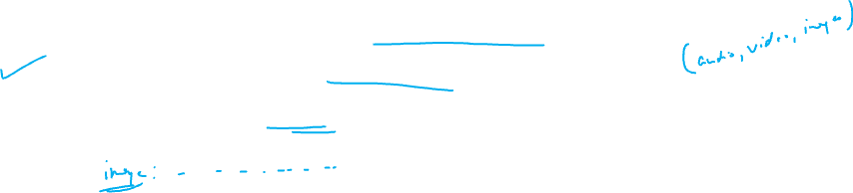
When to use PCA?
The variables in the dataset are multicollinear
When there are a huge number of features in the dataset
When you want to compress the data

Slide 4

Use cases
Image compression
Facial recognition

Slide 5
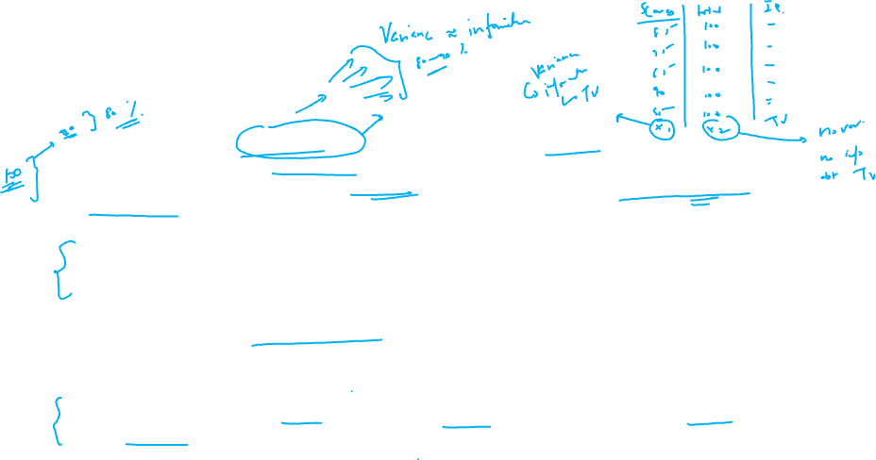
Example
Suppose there are 100 features that provide some information about the dataset. Since there are large number of features, it would generate volumes of dataset and hence there would be larger variance overall that gives lot of information about the dataset
.
But we need to reduce the number of features so that the data in manageable. Hence we consider only 20 features of the entire lot.
Definitely yes, some information is lost , since now only 20 features are considered , and not 100.
Hence the aim of PCA is to select those 20 factors which reflect the maximum variance of the dataset.

Slide 6
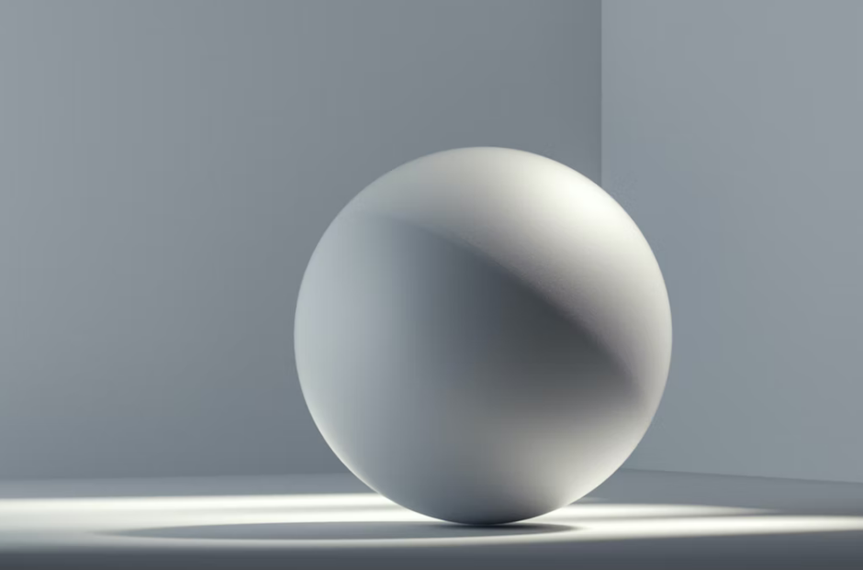

3 - D
2 - D

Slide 7
Hence the aim to select all those components of features that retain the maximum information.
In order to do so , different features are projected in different dimensions. Each dimension constitutes an important component of the dataset.
Our aim is to find out all such possible dimensions which provide more information about the dataset.

Slide 8
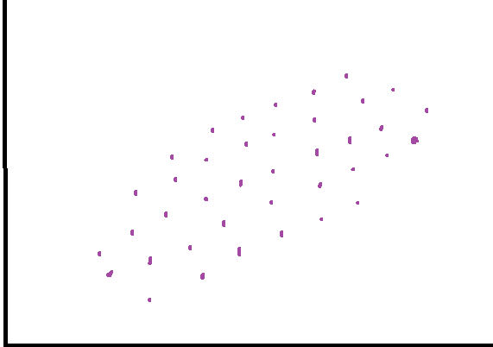
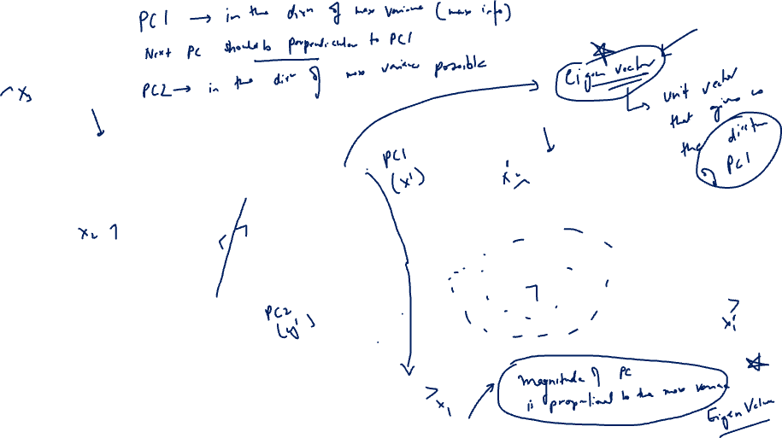
PC 2
PC 1

Slide 9
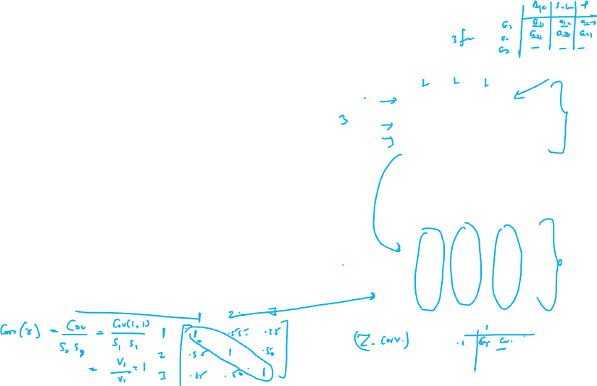
Steps in PCA:
Let x be a matrix of original data with n samples and n features , where n samples indicates the number of rows and n features indicate the number of columns.
First all the x values are converted to Z scores. In other words X matrix is converted to a normalized matrix

Slide 10
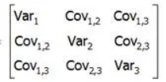
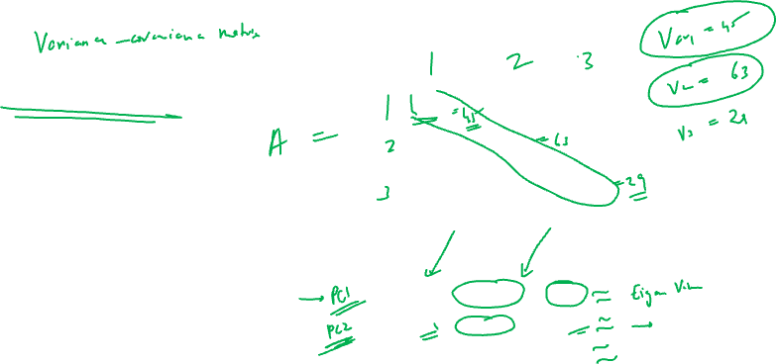
Next a covariance matrix is created
This matrix is then decomposed based on the decreasing values of variances.
Vector | Variance | Decreasing Order
Vector 1 | Var2 | 63
Vector 2 | Var 1 | 45
Vector 3 | Var 3 | 29

Slide 11
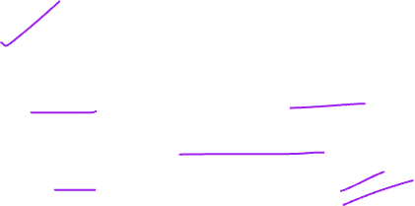
The vectors corresponding to highest variances (more information) are retained. These are called ‘Eigen Vectors’.
They give the direction of maximum variability
Vector | Variance | Decreasing Order
Vector 1 | Var2 | 63
Vector 2 | Var 1 | 45
Vector 3 | Var 3 | 29

Slide 12
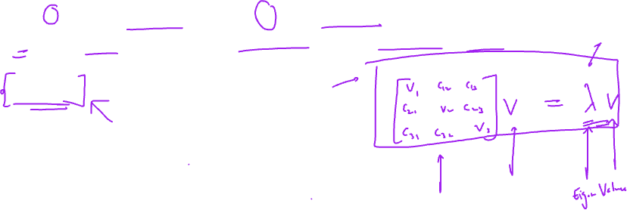
Calculation of Eigen Values and Eigen Vectors
Eigen vector: non-zero vector, that does not change its direction during transformation
Let v denote eigen vector and λ the eigen value
λ is the value by which the eigen vector is multiplied such that
Av = λ v
Where:
A = Variance Covariance Matrix
v = Eigen Vector
λ = Eigen values

Slide 13
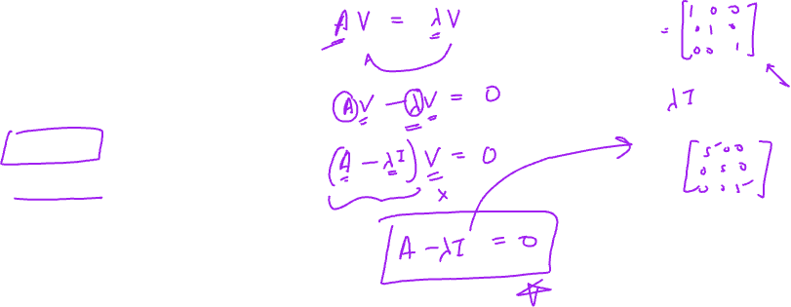
Av = λ v
(A – λI) v = 0
Since v not equal to 0
Hence det(A – λI) = 0
On solving this the eigen values are obtained

Slide 14
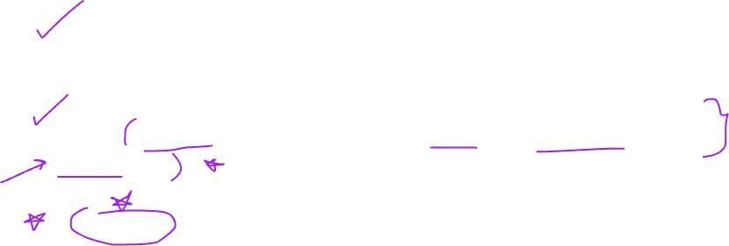
How to decide the number of components needed
Eigen vectors are unit vectors that show the direction of each principal component.
The coefficients that multiply to the eigen vector are called eigen values. They explain the amount of variance explained by each component.
A screeplot is a line plot of such eigen values of principal components.
The screeplot is used to determine the number of factors needed for a PCA model

